Slide 1

Sprint 9 - Retrospective
Team Lead: Brayden Chumbley Team Members: Ryan Grace, Carter Neeb, Jerritt Hung, Noah Guta, Eddie Bhandari, Talha Sadaqat

Slide 2
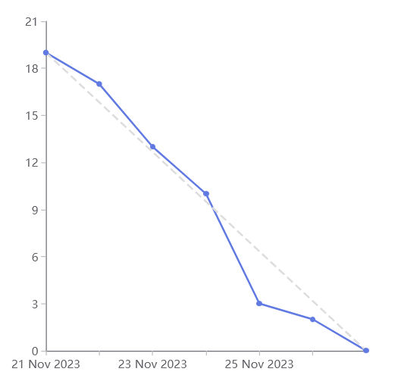
Sprint Summary
Overall, sprint went well!
Incorporated Agile methodology to add and manage additional tasks and their weights as required, ensuring the functionality of our project

Slide 3
Sprint 9 – Successes
Added save plan feature to web-application
Uses browser cookies to link a user's requests to our database of plans
Integrated planning feature with course tree to display planned courses
Course tree only displays relevant courses when a node is selected
Updated CI/CD pipeline to roll-back on failed tests

Slide 4
Sprint 9 - Struggles
Had to deviate from initial plan of user accounts for saving plans
Small issue when dealing with binary column in php

Slide 5
Brayden – Accomplishments (19 Weights)
Led sprint meetings and created issues to finalize application for in-class demo
Added 2 tables to database for saving student plans
Created database function to get a unique UUID for a new plan

Slide 6
Eddie – Accomplishments (20 Weights)
Created new saveplan endpoint that inserts/updates planned courses in the db(w/Carter)
Each course is saved using a course id and a plan id which correspond to the cookie id
Display planned courses for a set cookie on page load(w/Noah & Jerritt)
Fixing pytest issues on CI/CD pipeline + UI Accessibility Fixes(w/Noah)

Slide 7
Jerritt – Accomplishments (20 Weights)
Worked with Carter on creating 'getplan' API endpoint
Worked on saving course plan (button + cookie generation)
Worked with Noah and Eddie on loading course plan from cookie
Worked with Noah on highlighting planned courses in prerequisite graph

Slide 8
Carter – Accomplishments (20 Weights)
Paired with Ed to complete save plan endpoint to save planned courses
Paired with Jerrit to complete get plan endpoint for loading stored data
Paired with Noah to hide unrelated nodes when selecting a course in the tree
Added a rollback feature to the CI/CD if tests fail

Slide 9
Talha – Accomplishments (19 Weights)
Worked with Noah and Jerritt on highlighting planned courses in prerequisite graph
Took care of meeting notes

Slide 10
Noah – Accomplishments (21 Weights)
Pair Programmed with Carter to hide un-highlighted nodes
Paired with Jerritt and Talha to highlight planned courses green
Paired with Eddie and Jerritt to get planned courses from the cookie and display them on load
Worked with Eddie on fixing failed unit tests and some UI accessibility fixes

Slide 11
Ryan – Accomplishments (18 Weights)
Created UI tests for Online Planner -> Removing, Adding, Filtering courses
Created UI tests for Graphing -> Unique graph for specific courses
Around 30 test

Slide 12
Demo

